Slide 1
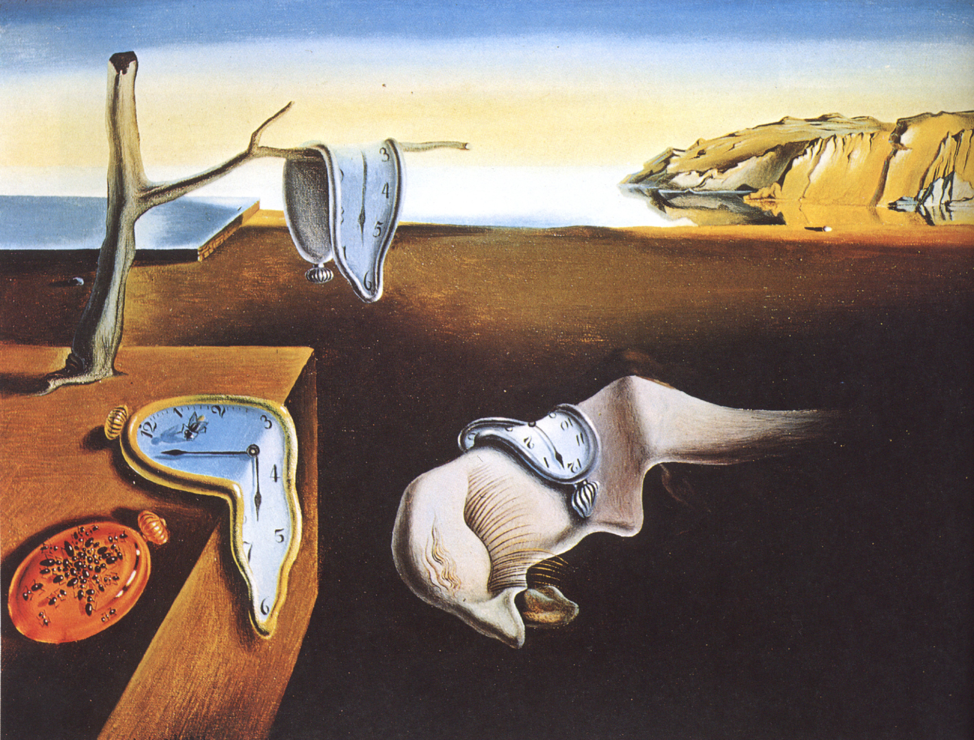
JamCoders: Week 1
Lecture 1B:
Data Types
(more) operators
casting

Slide 2
“Abstraction”
Abstraction: thinking with ideas instead of concrete details
For us, abstraction means that we can think on a higher level than binary
Instead of having to write 0000 0101, every time we want to have the number five, we can just write 5
my_number = 5 print(my_number)

Slide 3
Data Types
In order to abstract away how the computer is storing things, we use different data types.
The compiler will treat different data types differently
a = 9 + 7 print(a) b = "9" + "7" print(b)

Slide 4
Data Types
There are 13 built-in datatypes in Python, we mainly use these 9:
booleans, integers, floats, strings
lists, tuples, ranges
dicts, sets

Slide 5
Data Types
There are 13 built-in datatypes in Python, we mainly use these 9:
booleans, integers, floats, strings
lists, tuples, ranges
dicts, sets
Today, we will learn about the first 4. You’ll learn about the others over the next few weeks.

Slide 6
Booleans
Integers
Floats
Strings

Slide 7

Booleans
Booleans can be one of two options: True or False
Can be thought of as “is” types of questions: “Is it true that the state of my program is x?”
Is it true that the bison is wearing a hat?

Slide 8
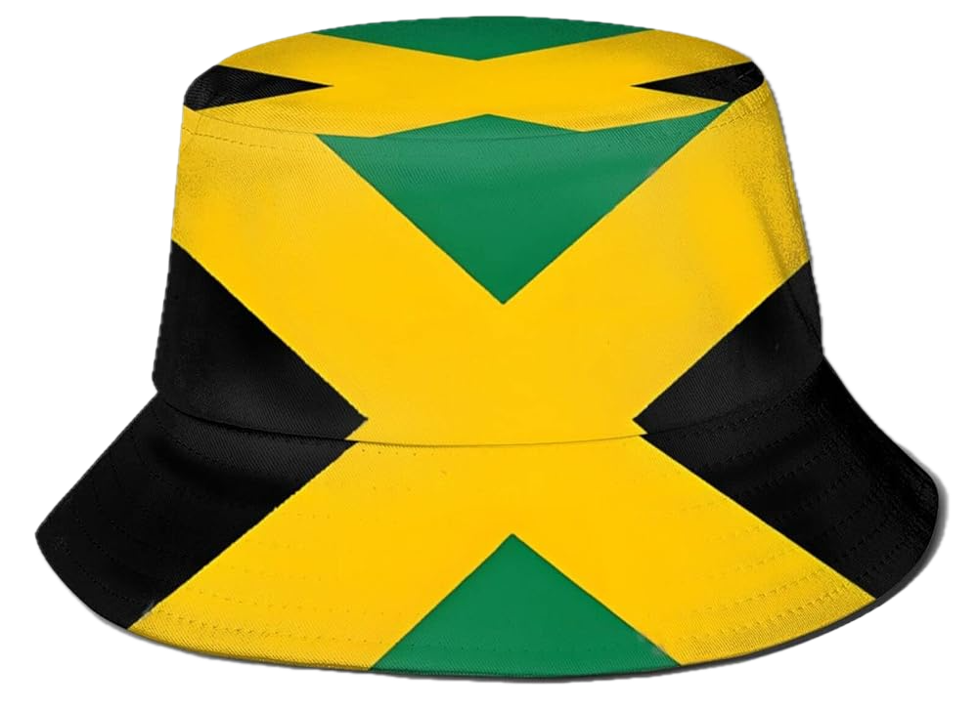
Booleans
Is it true that the bison is wearing a hat?
is_wearing_hat = False
is_wearing_hat = True

Slide 9
Booleans
Boolean True and False must be capitalized!
is_wearing_hat = False
is_wearing_hat = True

Slide 10
Booleans
How do we use booleans to do useful things?
Boolean True and False must be capitalized!
is_wearing_hat = False
is_wearing_hat = True

Slide 11
Operators

Slide 12
Operators
Operators are special symbols that are used to perform operations on values and variables.
A few different kinds that we use all of the time:
boolean operators
arithmetic operators
comparison operators
string operators
As we’ll see, the same operator will do a different thing depending on the data type.

Slide 13
Boolean Operators
not flips the boolean from one value to the opposite
is_absent = not is_in_class

Slide 14
Boolean Operators
not flips the boolean from one value to the opposite
and evaluates to True if both sides of the expression are True
is_absent = not is_in_class
can_buy_beer = has_funds and has_adult_id

Slide 15
Boolean Operators
not flips the boolean from one value to the opposite
and evaluates to True if both sides of the expression are True
or evaluates to True if either side of the expression is True
is_absent = not is_in_class
can_buy_beer = has_funds and has_adult_id
has_adult_id = is_over_18 or has_fake_id

Slide 16
Common Questions
Q: Why are these called booleans?

Slide 17
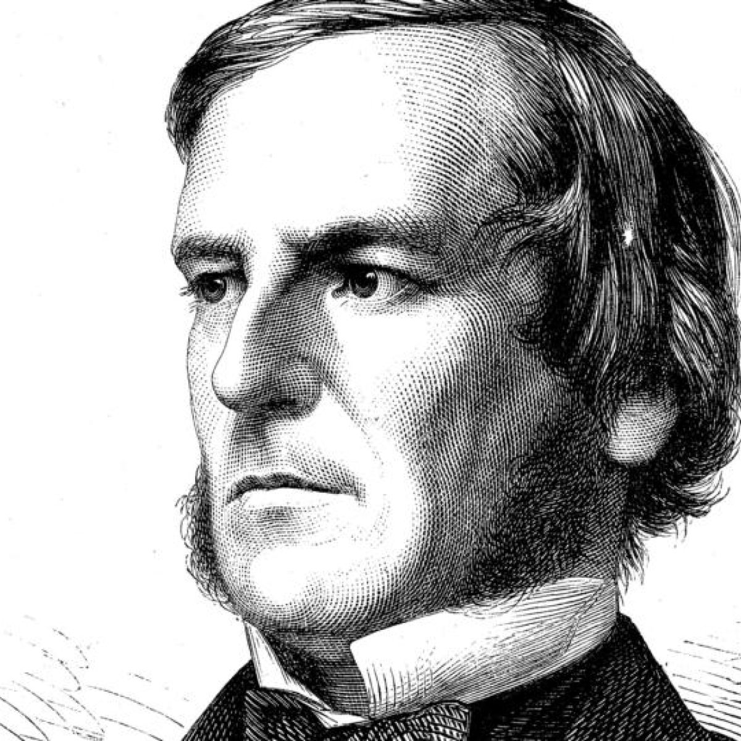
Common Questions
Q: Why are these called booleans?
George Boole was a British scientist who discovered algebra of logic - or using variables to represent True or False.

Slide 18
Booleans
Integers
Floats
Strings

Slide 19
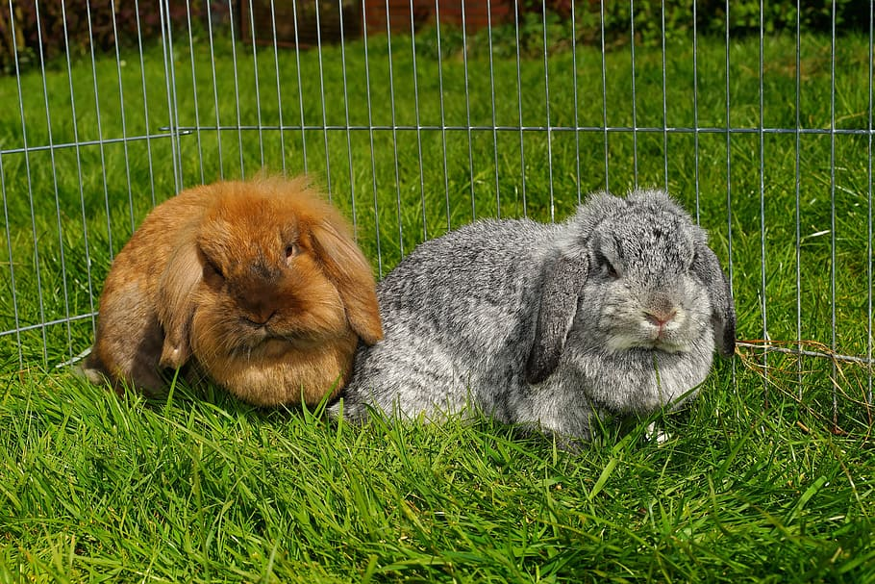
Integers
Integers are whole numbers.
How many bunnies?
Integers can be positive, negative,
or 0.
num_bunnies = 2

Slide 20
Review: Arithmetic Operators
The same operators that you’re used to in math work in Python.
Addition (+)
Subtraction (-)
Multiplication (*)
Division (/)
Exponentiation (**)
(this is the same as 2⁶)
sum = 5 + 6
power = 2 ** 6
diff = 12 - 5
product = 8 * 4
quot = 12 / 5

Slide 21
Review: Arithmetic Operators
If applying multiple operators, use parentheses to control the order they get evaluated, just like in math:
my_variable = 7 + ((20 / 4) ** 2) print(my_variable)
my_variable = 7 + ((20 / 4) ** 2)
my_variable = 7 + (5.0 ** 2)
my_variable = 7 + 25.0
my_variable = 32.0

Slide 22
Comparison Operators
It can be handy to be able to compare values. Python to the rescue…
All of the comparison operators evaluate to a boolean, True or False
Operator | Name | Example
> | Greater than | a > b
< | Less than | a < b
>= | Greater than or equal to | a >= b
<= | Less than or equal to | a <= b
== | Equal to | a == b
!= | Not equal to | a != b

Slide 23
Comparison Operators
It can be handy to be able to compare values. Python to the rescue…
All of the comparison operators evaluate to a boolean, True or False
Operator | Name | Example
> | Greater than | a > b
< | Less than | a < b
>= | Greater than or equal to | a >= b
<= | Less than or equal to | a <= b
== | Equal to | a == b
!= | Not equal to | a != b
Common mistake is to accidentally use one equals sign, =, which is used for variable assignment, instead of two equals signs, ==, for comparison.

Slide 24
Booleans
Integers
Floats
Strings

Slide 25
Floats
But what about representing numbers that aren’t whole numbers?
Money ($4.99)
Percentages and fractions (12%, 0.12)
GPA (3.51)
We use floats to represent real numbers.

Slide 26
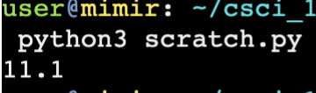
Arithmetic Operators
Float operators work the same way as int operators.
You can mix and match ints and floats, the result will always be a float.
summation = 5 + 6.1 print(summation)

Slide 27
Floats
Commonly Asked Questions
Q: Why is it called a float? Why not just call it a real number?
A: Take a Computer Architecture course and you’ll find out!
Q: When I do float arithmetic and print the result, I get a weird number? Did I do something wrong?
A: Representing fractions and decimals in binary is hard. Sometimes, the results will be off by a tiny bit (imprecise). That’s normal.

Slide 28
Booleans
Integers
Floats
Strings

Slide 29
Strings
A character is a single letter or symbol, like “c” or “!”
A string is a sequence of characters
In Python, anything within quotation marks is a string and is taken literally:
You can use double (“ ”) or single (’ ’) quotation marks, just be consistent.
x = "hello"

Slide 30
String Operators
Concatenating Strings: + (add)
Repeating a string: * (multiply)
Prints “hahaha”
name = "Frederick” greeting = "Hello, “ + name
laugh = "ha” laugh_harder = laugh * 3 print(laugh_harder)

Slide 31
String Comparison Operator
To determine if two strings are equal, use the == operator. Note that it is case sensitive.
Prints False, because the strings are different.
first_school_name = "Berkeley" second_school_name = "Stanford" print(first_school_name == second_school_name)

Slide 32
String Length
This one isn’t an operator, but is still useful to know:
len() - given a string, returns the length of that string
length = len("Bison")

Slide 33
Working with Types

Slide 34
Casting
Casting is how we converting between different types.
You cast a variable or value of one type to another type by using the function of the destination type:
int() to convert something to an integer
str() to convert something to a string
float() to convert something to a float
bool() to convert something to a boolean

Slide 35
Casting
String to int/float or vice versa is most common
Use int(“8”) to convert the string “8” to the integer 8.
Use str(8) to convert the integer 8 to the string “8”
num_of_apples = "9" num_of_bananas = "7" print(int(num_of_apples) + int(num_of_bananas))

Slide 36
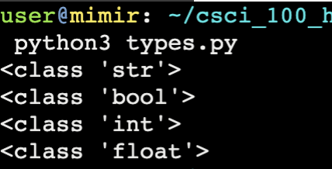
Finding the type of a variable
We can use the type() function to find out the type of any variable.
var1 = "Alex" var2 = True var3 = 12 var4 = 7.5 print(type(var1)) print(type(var2)) print(type(var3)) print(type(var4))

Slide 37
Expressions

Slide 38
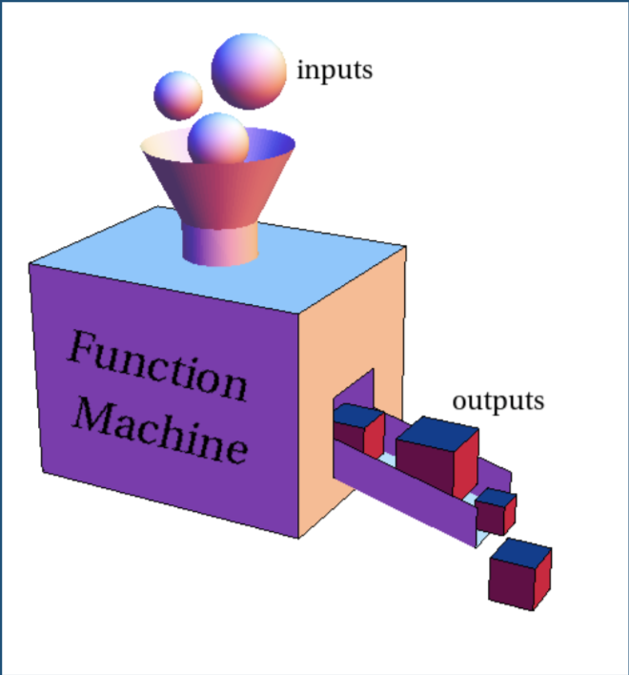
Functions
Functions take input, perform some task, and optionally give an output.
Function calls are also expressions, and can be used as operands.
Examples
str() is a function that evaluates to a string
int() is a function that evaluates to an integer.
We’ll learn much more about functions on day 3. For now, just know that function calls are expressions.

Slide 39
Expressions
We stop evaluating expressions once they simplify down to a single value, known as an “atom”, which can either be an identifier (variable name) or a literal.
"Result: " + str((2 ** 6) / 4)
"Result: 16"

Slide 40
Expressions
Variables and literals are interchangeable! Both of these do the same thing:
name = "Bison" opening = "Hello, " greeting = opening + name print(greeting)
name = "Bison" opening = "Hello, " print(opening + name)

Slide 41
Expressions
What is the expression here?
name = "Bison" opening = "Hello, " greeting = opening + name print(greeting)
name = "Bison" opening = "Hello, " print(opening + name)

Slide 42
Expressions
What is the expression here?
Code works fine, whether we assign the expression value to a name or not.
name = "Bison" opening = "Hello, " greeting = opening + name print(greeting)
name = "Bison" opening = "Hello, " print(opening + name)

Slide 43
Input

Slide 44
Input
We learned “output” for how to print stuff out to the terminal. Now, we will learn how to take things in from the terminal.
New function!
answer = input("Prompt")

Slide 45
Input
We learned “output” for how to print stuff out to the terminal. Now, we will learn how to take things in from the terminal.
New function!
Prints “Prompt” to the screen, then waits for user to provide input.
answer = input("Prompt")

Slide 46
Input
We learned “output” for how to print stuff out to the terminal. Now, we will learn how to take things in from the terminal.
New function!
Prints “Prompt” to the screen, then waits for user to provide input.
We assign the words that the user types in to the variable answer.
answer = input("Prompt")

